Slide 1
BIRTH CANAL INJURIES
Dr soodabeh Sadeghi jahromi
prinatology fellowship
_7/11/1402

Slide 2
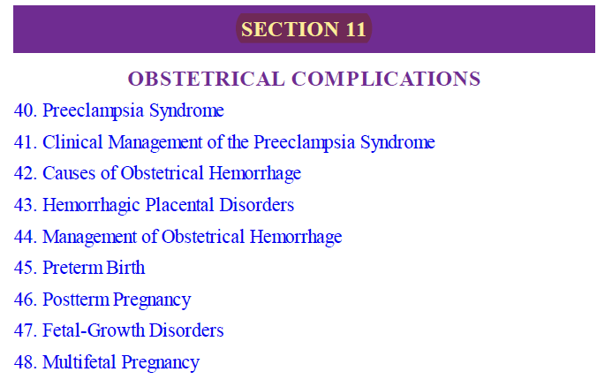
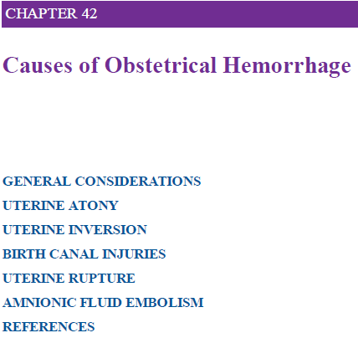
-BIRTH CANAL INJURIES
-UTERINE RUPTURE

Slide 3
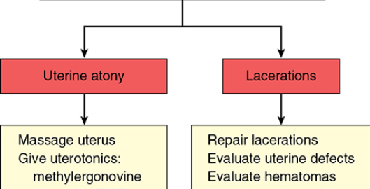
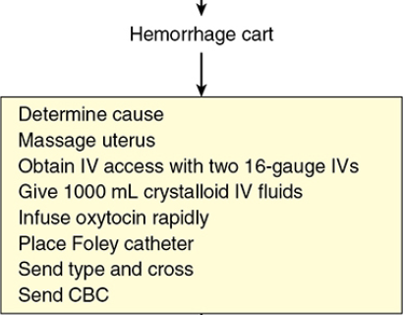
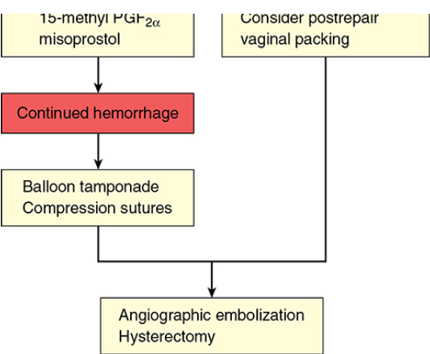
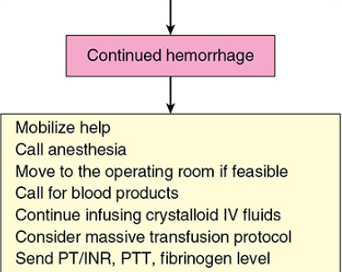

Slide 4
Case presentation
A 25 Y/O null gravid
Uncomplicatad NVD with RIGHT episiotomy
Obsrve in laber room
Progess with tachycardia ,no urin ,loss of consciousness
Hb drop???
DEEP laceration of Cervix,LEFT SIDE & Retroperitoneal Hematoma
Laparatoy and Repair

Slide 5
BIRTH CANAL INJURIES
Vulvovaginal Lacerations
Cervical Lacerations
Puerperal Hematomas

Slide 6
Vulvovaginal Lacerations
Childbirth is invariably associated with trauma to the uterus and cervix, vagina, and perineum.
Injuries range from:
minor mucosal tears
lacerations
(create life-threatening hemorrhage or hematomas.)

Slide 7
American College of Obstetricians and Gynecologists (2020a) : up to 80 percent
of women sustain some type of laceration at vaginal birth.
These may lie “proximally” or distally along the lower genital tract.

Slide 8
Tears of the “vaginal wall near the urethra”
relatively common
Superficial
little to no bleeding
occasionally require:
(fine-gauge absorbable sutures for hemostasis)
Those large enough require: extensive repair
( typically associated with short-term voiding difficulty,
and an indwelling bladder catheter will obviate this)

Slide 9
Lacerations of the “middle or upper third of the vagina”
usually are comorbid with injuries of the perineum or cervix
These sometimes are missed
unless inspection is thorough.
Those that extend upward usually are longitudinal.
may follow spontaneous delivery
frequently result from injuries sustained during operative NVD

Slide 10
Lacerations Involve deeper underlying tissues
usually cause significant hemorrhage
is controlled by suture repair:
effective analgesia OR anesthesia
clear visualization
capable assistance
Sufficient “resuscitation of hypovolemia are mandatory”

Slide 11
Extensive vaginal or cervical tears should prompt a careful search for
evidence of:
retroperitoneal hemorrhag
peritoneal perforation with hemorrhage
If peritoneal perforation or uterine rupture is
strongly suspected, laparotomy is reasonable

Slide 12
Cervical Lacerations
Superficial lacerations :
More than half of all vaginal deliveries
can be seen on close inspection
measure <0.5 cm and seldom require repair

Slide 13
Cervical Lacerations
Deeper lacerations :
are less frequent
may be unnoticed
more likely to be associated with
vacuum- or forceps-assisted vaginal delivery

Slide 14
Cervical lacerations are not usually problematic unless:
-Cause hemorrhage
-Extend to the vagina

Slide 15
…tears
cervical tears reach into the lower uterine segment
Involve the uterine artery and its major branches
They occasionally extend into the peritoneal cavity
More severe lacerations usually manifest as :
External hemorrhage or as a hematoma
They may occasionally be unsuspected
Almost 11 percent of women with a cervical laceration required blood transfusions

Slide 16
The edematous anterior cervical lip is compressed between the fetal head and maternal symphysis pubis.
This usually is of little consequence and resolves spontaneously.
Rarely, this causes severe ischemia, and the
anterior lip may undergo necrosis and later separate from the rest of the cervix.

Slide 17
colporrhexis Annular & ( circular detachment)
Rare
Avulsion of cervix from the vagina
In the anterior, posterior, or lateral fornices
Entirely or partially
Rare injury
avulsion of the
entire vaginal portion of the cervix
These injuries sometimes follow forceps deliveries performed through an
incompletely dilated cervix and with the blades applied against the cervix

Slide 18
ANY QUESTION ?

Slide 19
Diagnosis-treatment of Cervical Lacerations
adequate exposure
(may be best attained with transfer to an operating room)
An First assistant applies firm downward pressure on the uterus
while the operator exerts gentle traction on the lips of the cervix with ring forceps.
A Second assistant can provide even better
exposure with right-angle vaginal wall retractors or Breisky vaginal
retractors.

Slide 20
repaire of cervical lacerations
Deep cervical tears usually require surgical repair
When the laceration is limited to the cervix or even when it extends somewhat into the vaginal fornix, satisfactory results are obtained
suturing the cervix after bringing it into view
While cervical lacerations are repaired, any associated vaginal lacerations or an episiotomy may be tamponaded with gauze packs to arrest their bleeding.

Slide 21
Because hemorrhage usually comes from the upper angle of the wound, the first suture using 2–0 chromic or polyglactin is placed in tissue above the angle
either interrupted or continuous” locking “sutures are serially placed outward toward the operator.

Slide 22
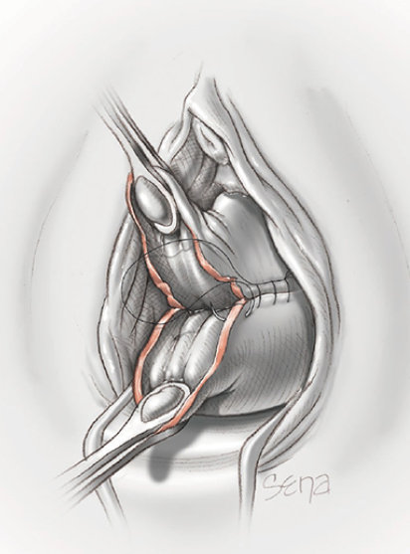
Repair of cervical laceration with appropriate surgical exposure. Continuous
absorbable sutures are placed beginning at the upper angle of the laceration.

Slide 23
Following cervical lacerations, subsequent pregnancy outcomes
include :(Hamou, 2020).
excessive recurrent lacerations
cervical incompetence
preterm labor
cesarean delivery
severe perineal lacerations

Slide 24
In General:
cervical lacerations of 1 to 2 cm are not repaired unless they
are bleeding.
Such tears heal rapidly
ultimately form an irregular, sometimes stellate-appearing, external cervical os

Slide 25
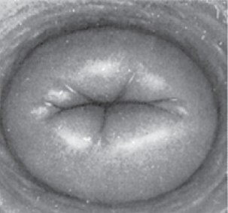
Common appearance of stellate-appearing, external cervical os

Slide 26
THANK YOU FOR YOUR ATTENTION

